Slide 1
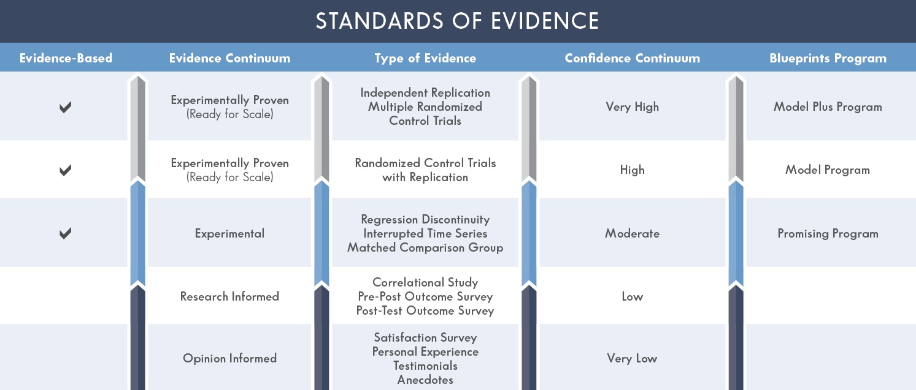
Abstract
Measuring Effectiveness During Widescale Implementation of LifeSkills Training
Center for the Study and Prevention of Violence
University of Colorado Boulder
^{Brittany Weeks, BA}
^{Nicole Pasminski, BA}
^{Jessica Green, MA}
During a wide scale execution of evidence-based programs, it is not uncommon to lose some measure of program effectiveness due to lack of fidelity and implementation issues. Additionally, it may seem logical to rely on the strong positive long and short term effects during research trials when implementing an evidence-based program. However, this does not always appropriately measure effectiveness. Botvin’s LifeSkills Training (LST) program is an evidence-based drug and violence prevention program for middle schools. The three basic components of the program include personal self-management skills, social skills, and resistance techniques. In 2013, school districts in Pennsylvania were given the opportunity to participate in a wide-scale roll-out of LST through a grant disseminated by the Center for the Study and Prevention of Violence (CSPV) at the University of Colorado Boulder; 52 districts elected to participate. In partnership with the program developer, Dr. Gilbert Botvin, schools received expert training and technical assistance. CSPV monitored program fidelity through teacher training workshops, classroom observations, semi-structured interviews, and teacher feedback surveys. CSPV utilized this data to provide annual feedback reports to each district detailing implementation strengths and opportunities for improvement.
The state of Pennsylvania funded an evaluation team from the Evidence-based Prevention and Intervention Support Center (EPISCenter) to collect and analyze pre-post outcomes across participating school districts. Both process and outcome data, including pre- and post-test scores, was gathered from 23 school districts. Results from the surveys suggested increased knowledge of relaxation skills, assertiveness skills, and knowledge of drugs. These results are indicative of an effective program model that enhances life skills while minimizing risk behavior. The following discussion examines the role of fidelity in student post-test results. Additionally, CSPV has identified tools and methods to increase feasibility of data collection, use data for continuous quality improvement, secure additional funding, and to provide feedback reports.
Botvin’s LifeSkills Training
Grant Structure
Year 1
Level 1 (6th grade) teachers receive initial training.
Level 1 implementation begins (15 core sessions, 3 optional violence lessons).
Year 2
Level 2 (7th grade) teachers, and new Level 1 teachers, are trained.
Returning teachers receive booster workshop.
Level 2 implementation begins in 7th grade (10 core, 2 optional violence).
Incoming 6th-grade students receive Level 1 (15/18 LST lessons).
Year 3
Level 3 (8th grade) teachers, and new Level 1 and 2 teachers, are trained.
Returning teachers receive booster workshop.
Level 3 implementation begins in 8th grade (5 core, 4 optional violence).
6th-grade students receive Level 1 (15/18 LST lessons).
7th-grade students receive Level 2 (10/12 LST lessons).
LifeSkills Training (LST) is a Blueprints Model Program developed by Dr. Gilbert Botvin, a professor of Public Health and Psychiatry and Director of Cornell University’s Institute for Prevention Research. It is an evidence-based substance abuse and violence prevention program designed to help youth resist drug, alcohol, tobacco use, and other high-risk behaviors.
The middle school LST program consists of three levels. Level 1 includes 15 core lessons and 3 optional violence prevention lessons. Level 2 consists of 10 booster lessons that expand on topics addressed in the previous year, and 2 optional violence prevention lessons. Level 3 reinforces skills learned in previous years with 5 core lessons and 4 optional violence prevention lessons.
In 2013, the Center for the Study and Prevention of Violence (CSPV) offered school districts in Pennsylvania the opportunity to participate in a wide-scale roll-out of LST. Fifty-two school districts elected to receive the grant funding. The EPISCenter evaluated pre- and post-data from participating districts. Their findings can be viewed below:
Blueprints
The Blueprints initiative for Healthy Youth Development identifies, recommends, and disseminates highly effective evidence-based programs for youth. It offers a registry of programs that have strong evidence for effectiveness designed to promote the health and well-being of children and teens. This continuum of programs are based in families, schools, and communities. They target all levels of need — from broad prevention programs that universally decrease negative behavior to intervention programs specifically tailored for at-risk and problem-behavior youth. The Blueprints registry is used as a resource for governmental agencies, schools, and communities aiming to invest in highly effective youth development programs. The initiative’s ultimate goal is to reduce antisocial behavior while promoting a healthy trajectory of youth development.
Blueprints has reviewed over 1,400 and designated less than 5% as model and promising programs. Designated programs have scientifically demonstrated improvement in positive youth development in domains of academic achievement, emotional regulation, physical health, and pro-social relationships. Additionally, Blueprints programs cultivate coping skills that empower young people to overcome challenges associated with delinquency, violence, and substance abuse.
Both promising and model programs must meet basic Blueprints standards. However, model programs meet additional requirements. Promising programs must have evidence from one high-quality experimental design or two high-quality quasi-experimental designs, clear findings of effective results, carefully determined goals, and sufficient resources to help users. Model programs must have evidence from two high-quality experimental or one experimental and one quasi-experimental design of high quality. Additionally, efficacy must be sustained for at least 12 months after the intervention concludes. Model programs with a high-quality "independent" replication are labeled as Model Plus. Blueprints deems Model and Model Plus programs ready for application.
Example: Knowledge of LST Domains
Process Evaluation
Site Visit:
CSPV representative meets with site coordinator, teachers, principals, and observers.
CSPV representative co-observes one or more LST lesson (reliability observation).
Teacher Survey:
LST teachers complete brief online survey after the first full cycle.
Site Coordinator Survey:
Site coordinator completes brief survey at the end of the year.
Sustainability Assessment (After conclusion of grant):
Site coordinator is contacted one and two years following the grant to assess status of LST.
Classroom Observations:
Purpose: Provides data to generate fidelity score; Observers complete a checklist that corresponds to lesson objectives.
Year 1: 4 observations per Level 1 (L1) teacher
Year 2: 4 per L1 teacher, 3 per L2 teacher
Year 3: 4 per L1 teacher, 3 per L2 teacher, 2 per L3 teacher
Annual Reports:
Purpose: details implementation, identifies strengths/challenges, suggests opportunities for improvement.
Sections:
Trainings
Recaps workshop and incorporates teacher evaluation data (satisfaction, effectiveness).
Site Visit
Summary of meetings & structured interviews.
Classroom Observations
Summarizes observation data (fidelity score, student participation and engagement, teaching techniques, etc.).
Teacher Feedback
Reports survey data (teaching fidelity, average time per class, satisfaction with program, etc.).
Sustainability
Acknowledges effort made to support program longevity and total grant value.
Strengths/Challenges
District recognized for effective implementation strategies and program guideline adherence.
Challenges identified and opportunities for improvement suggested.
Often, the term “Evidence-Based Programs” confuses consumers due to varying definitions and ambiguity regarding minimal requirements to prove effectiveness. Blueprints for Healthy Youth Development has developed an Evidence Continuum that clarifies selection criteria to warrant the “Evidence-Based Program” label. This can be viewed in the graphic to the left.
Evidence demonstrating the effectiveness of a program, policy, or practice falls on a continuum of confidence, ranging from high to low. A more rigorous research design and a greater number of positive evaluations supports user confidence in the effectiveness of the intervention/prevention program.
Sample Size: 3814 students, 66% White, 15% Multiracial, 8% African American, 7% Hispanic, 2% Asian, 2% American Indian/Alaska Native, 49% female
Every short-term outcome showed significant improvement from pre- to post-test.
Sessions were delivered overall with high levels of adherence and quality.
Adherence was especially important for increasing overall life skills knowledge.
14 Model Programs:
Promoting Alternative Thinking Strategies (PATHS)
LifeSkills Training (LST)
Positive Action
Project Towards No Drug Abuse
Brief Alcohol Screening and Intervention for College Students
Blues Program
Body Project
Functional Family Therapy (FFT)
Multidimensional Treatment Foster Care (MTFC)
Multisystemic Therapy® (MST®)
Multisystemic Therapy® - Problem Sexual Behavior
New Beginnings (Intervention for Children of Divorce)
Nurse-Family Partnership
Parent Management Training
36 Promising Programs:
Adolescent Coping with Depression
Adolescent Transitions Program
ATLAS (Athletes Training and Learning to Avoid Steroids)
Be Proud! Be Responsible!
Behavioral Monitoring and Reinforcement Program
Big Brothers Big Sisters of America
Bright Bodies
Cognitive Behavioral Intervention for Trauma in Schools (CBITS)
Communities That Care (CTC)
Coping Power.
Early Literacy and Learning Model (ELLLM)
EFFEKT
Familias Unidas
Good Behavior Game
Guiding Good Choices
HighScope Preschool
Incredible Years® - Child Treatment
Incredible Years® - Parent
Incredible Years® - Teacher Classroom Management Program
InShape
Olweus Bullying Prevention Program
Parent-Child Interaction Therapy (PCIT)
Peer Assisted Learning Strategies (PALS)
Project Northland
Quick Reads
Raising Healthy Children
Safe Dates
SPORT
Steps to Respect
Story Talk - Interactive Book Reading Program
Strengthening Families Program for Parents and Youth 10-14
Strong African American Families (SAAF) Program
Success for All
Targeted Reading Intervention.
Triple P System
Wyman's Teen Outreach Program®

